Slide 1
Abusive and Slang Words in Indonesia
Binar DSC Wave 9 Gold Challenge
Rina Yulius

Slide 2
Introduction
The influence of social media, particularly platforms like Twitter, on the development of slang language is a significant aspect of language evolution in today's digital age.
The proliferation of social media platforms has provided individuals with an unprecedented ability to express themselves freely. However, this freedom also poses challenges, as it can lead to the spread of offensive language and hate speech, potentially fueling conflicts between netizens.
How to identify hate speech/abusive word?

Slide 3
Goal
To create an API to clean text data (non-formal text/slang/abusive) including symbols, punctuations, extra spaces, etc from dataset
The dataset can be accessed via this link

Slide 4






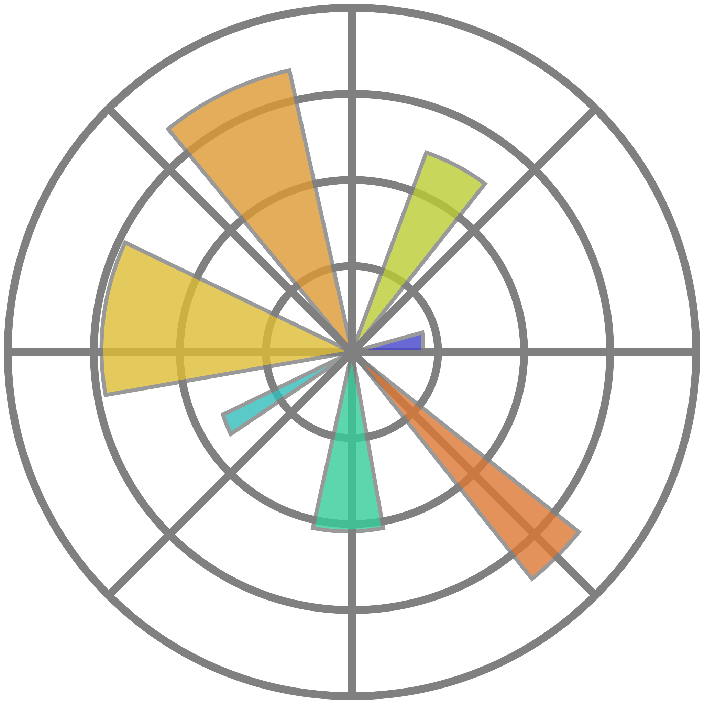




Tools
Code Editor
Languange
API Processing
API Visualization
Version Control
Database
Data Visualization
Data Visualization
Report
Library
Library

Slide 5
Methods
Create a python program using:
a) Pandas & Regex for data cleansing
b) Matplotlib & Seaborn for data visualization
c) Flask & Swagger UI for API building
Input text manually into API
Create form to upload csv file
Save all the processed data in a SQLite database named ‘gold_challenge.db’

Slide 6
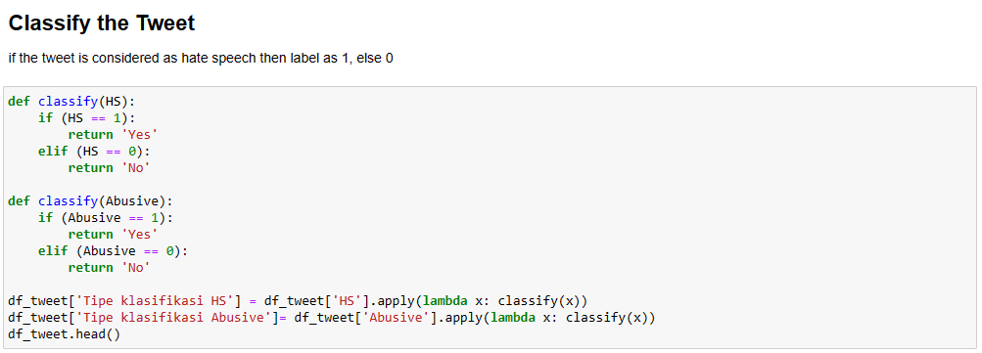
Classify the tweets from csv file (labelling)

Slide 7
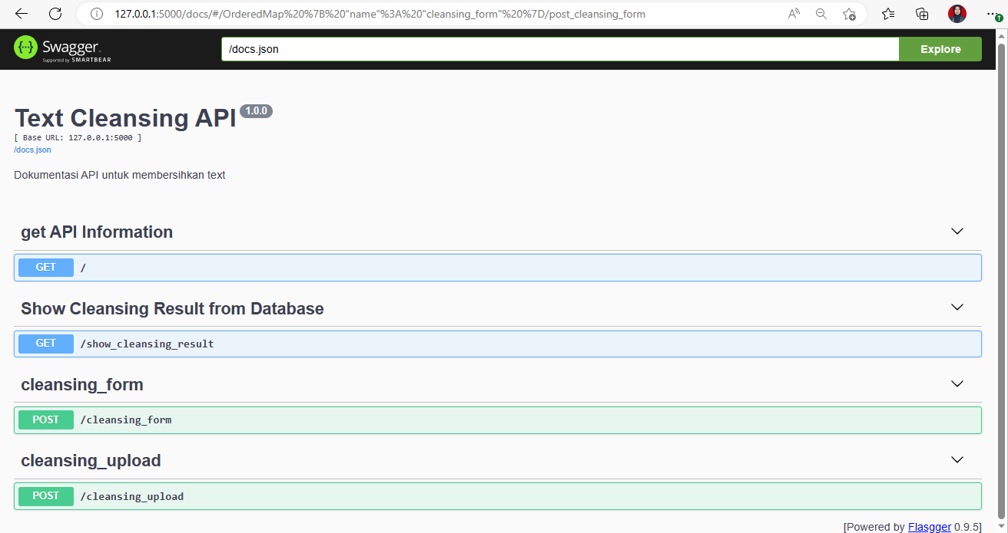
Results – UI
Get API info
Show the cleansing result from db
Cleansing file using input text
Cleansing file using upload csv form

Slide 8
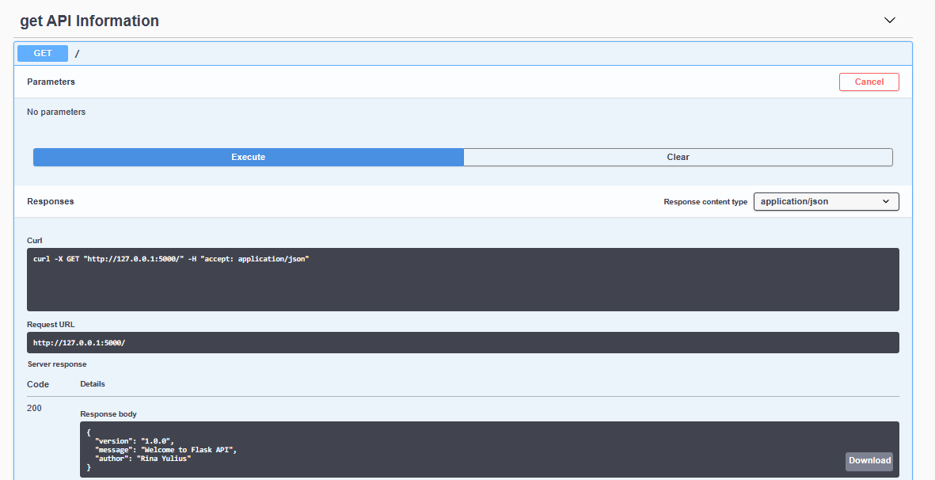
Results - API Information

Slide 9
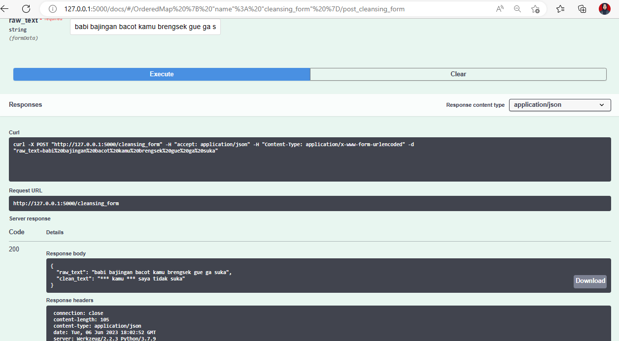
Results – Cleansing Form

Slide 10
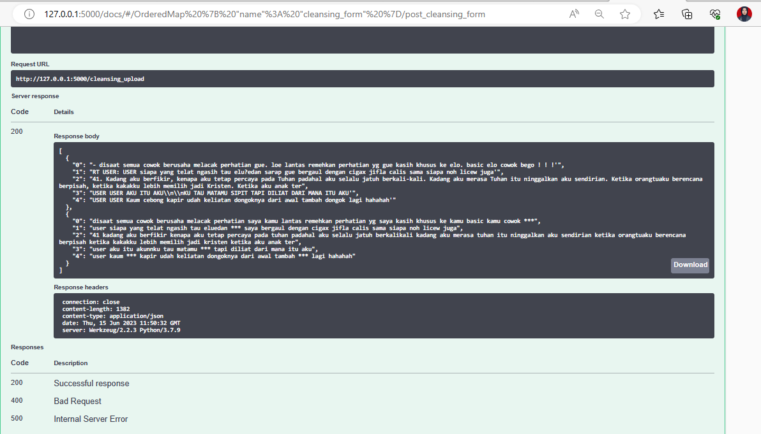
Results – Cleansing Upload

Slide 11
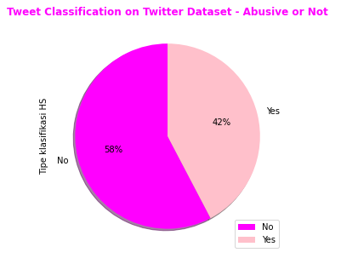
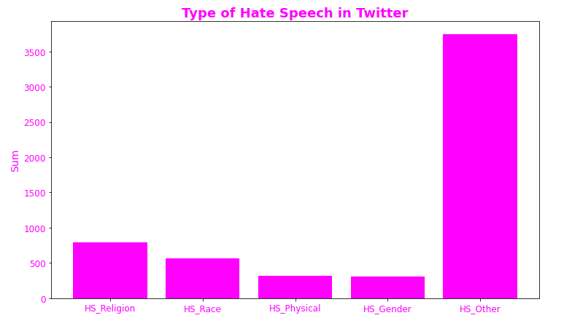
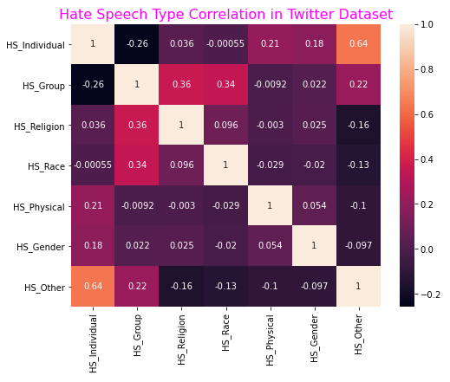
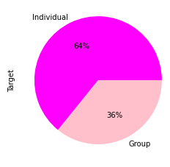
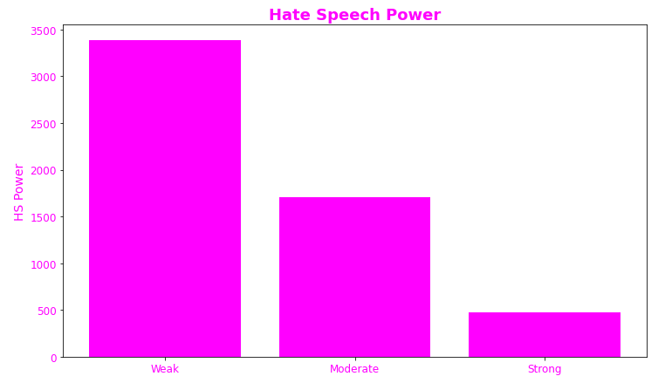
Data Visualization

Slide 12
Conclusions
Text cleaning can be done through Swagger UI with two kinds of input, namely through manual input and uploading a CSV file
Based on data processing result, we can conclude that almost half of tweets in the dataset consists of hate speech and abusive words
Approximately 64% of tweets containing hate speech are targeted at specific individuals.

